Slide 1
MS Office 365
Computer Club 101

Slide 2

Onedrive
Onedrive is a program that can sync the files in your computer 24/7 when online.
For school accounts, it has 1TB of storage, which is about 8.3 times bigger than your computer size. (120GB * 8.3 = approx. 1000GB)

Slide 3
Installation of onedrive
Self-Service

Slide 4
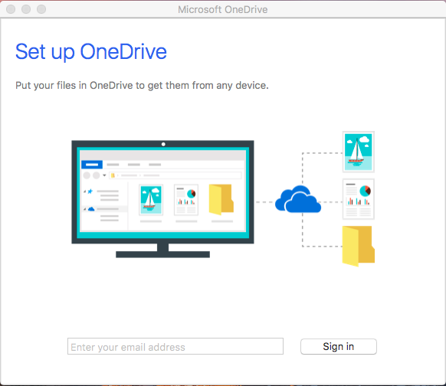
Usage of onedrive in general
Turn on the Onedrive.app
There will be a space where it requires to enter your school account.
Enter your school account.

Slide 5
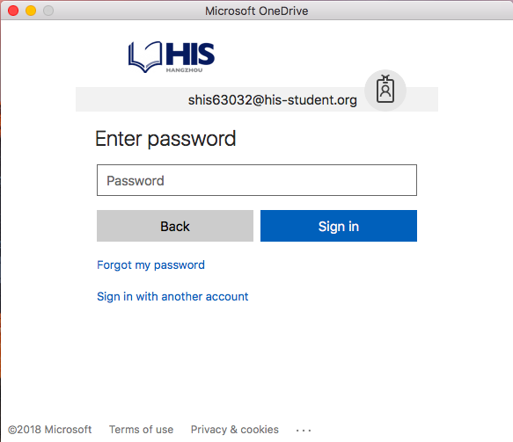
Usage of onedrive in general
After you entered your school account, you will proceed to login page.

Slide 6
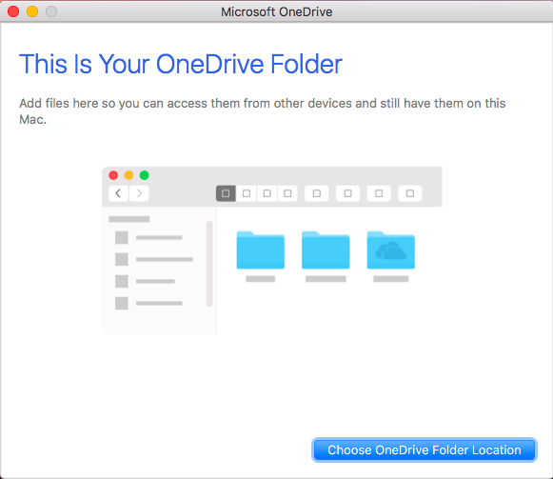
Usage of onedrive in general
Successful access will encounter this page.

Slide 7
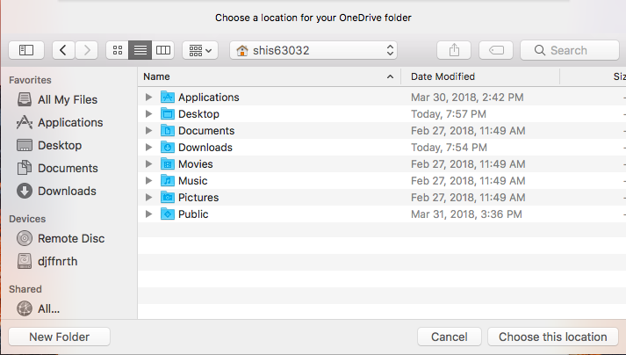
Usage of onedrive in general
Choose the location where your OneDrive Folder will be.

Slide 8
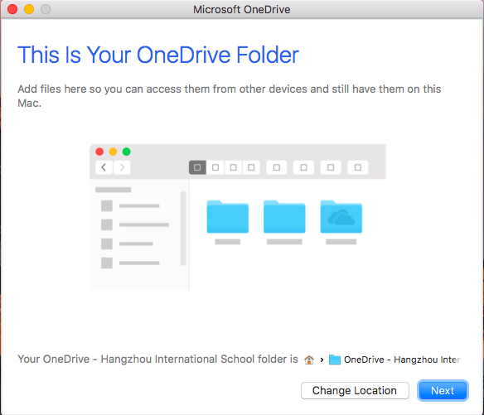
Usage of onedrive in general
After you have confirmed the location, you either can go back by ”Change Location” or proceed to next by clicking “Next”.

Slide 9
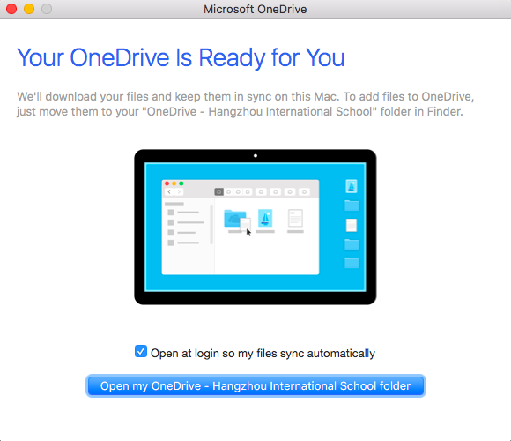
Usage of onedrive in general
By pressing the checkbox in the middle, OneDrive will be opened when your computer is on.
Click the blue bar to continue…

Slide 11
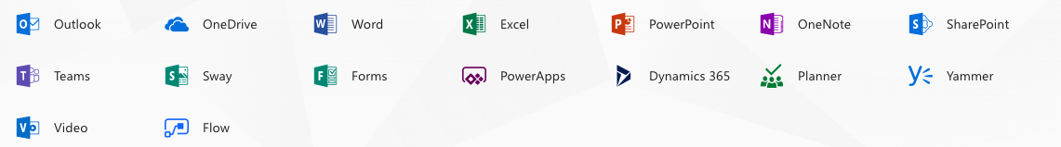
Office 365
Office 365 gives various service that you will never see again after, in personal account.
Why don’t we use more efficiently?

Slide 12
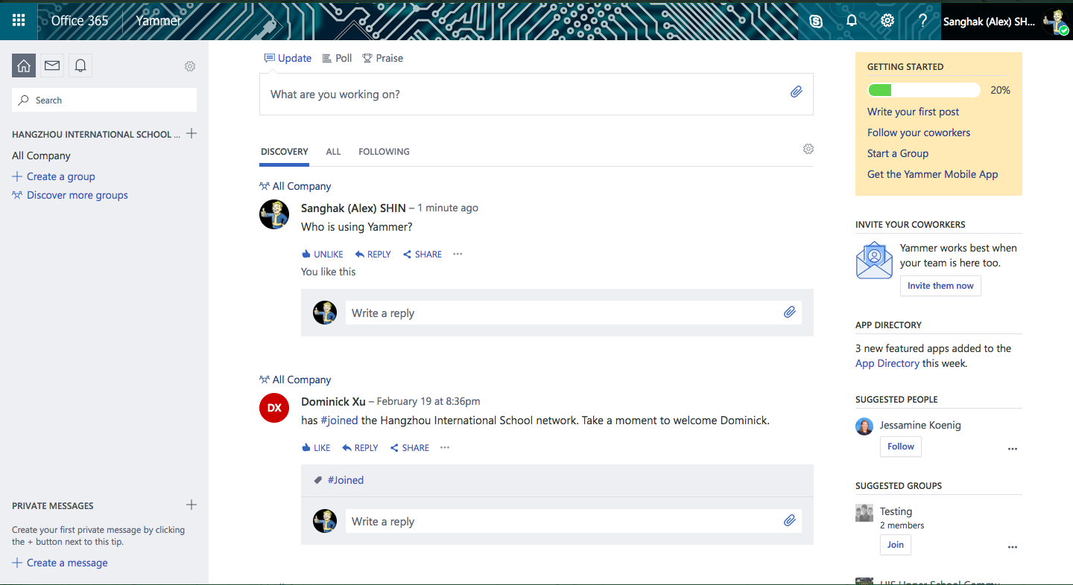
Various office 365 services - Yammer

Slide 13
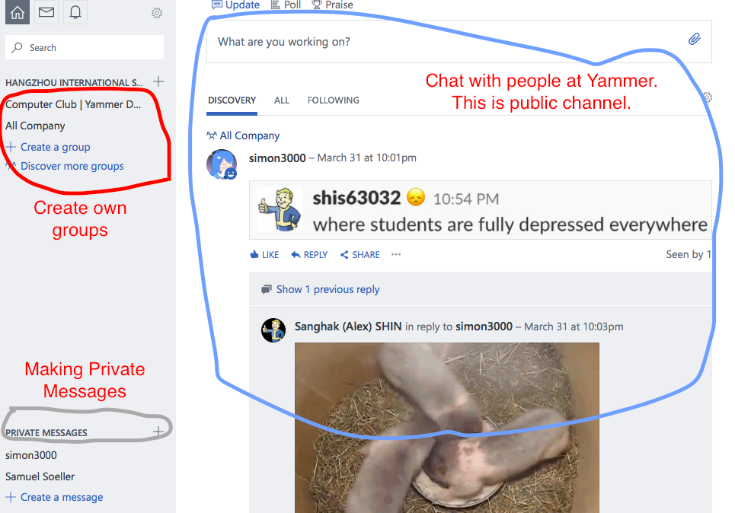

Slide 14
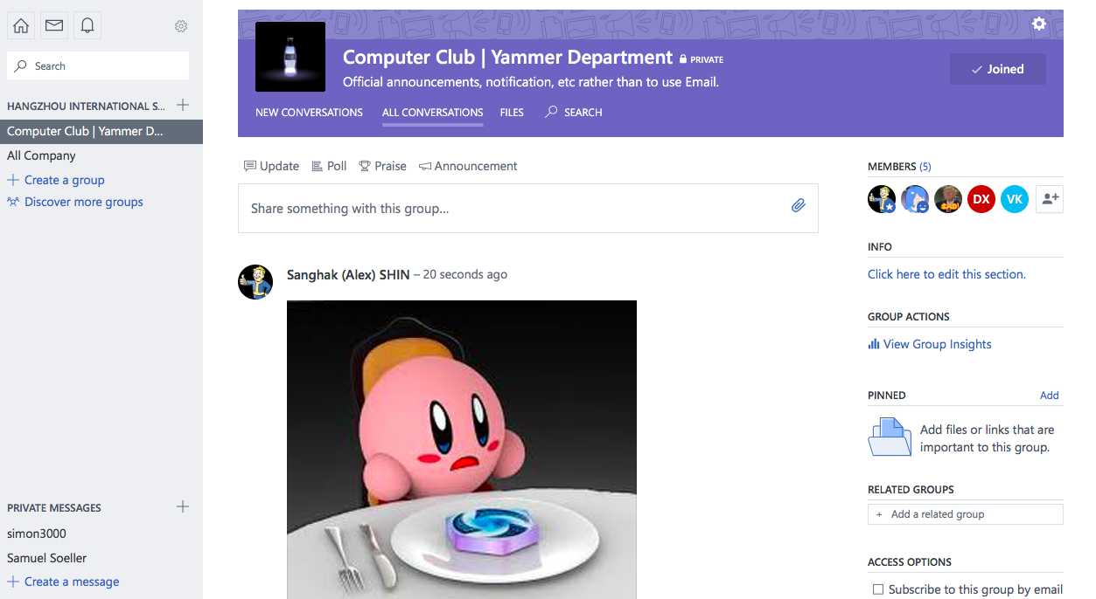

Slide 15
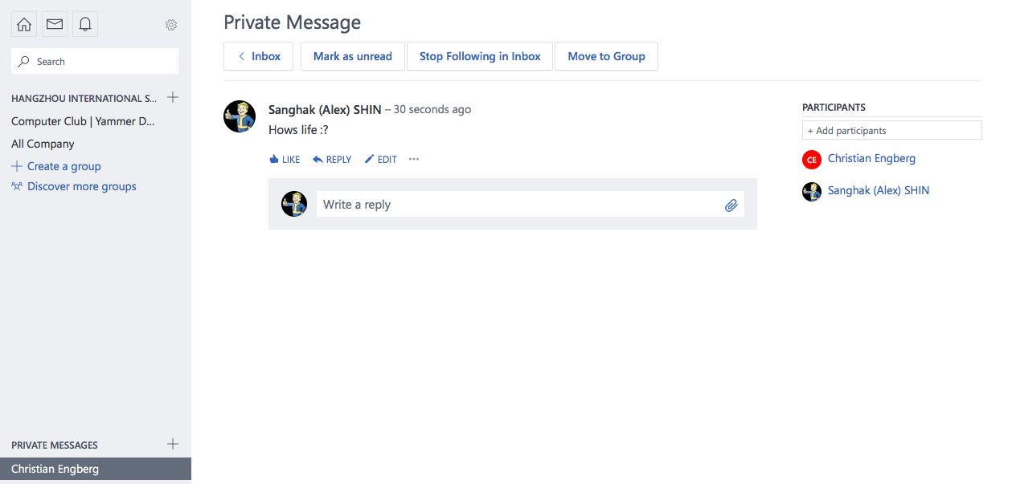

Slide 16
Various office 365 service - yammer
Yammer is an communication app that can be used to contact anyone in the school with the school account.
Just like any SNS, you can do various things that you want to do.

Slide 17
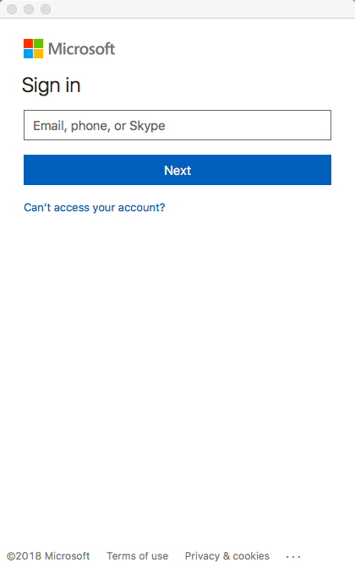
Various office 365 service – Microsoft teams
Click on “Microsoft Teams” after you have installed from the Self-Service.
Log in with your school account.

Slide 18
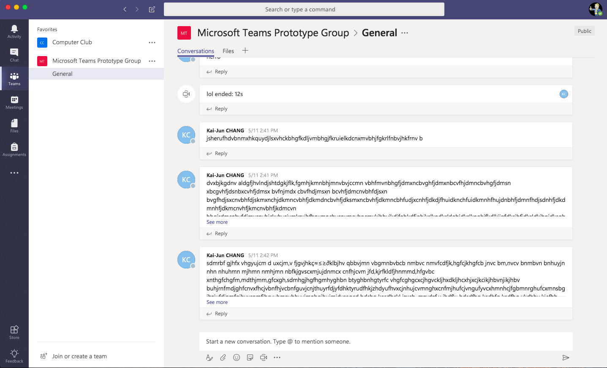
Various office 365 service – Microsoft teams

Slide 19
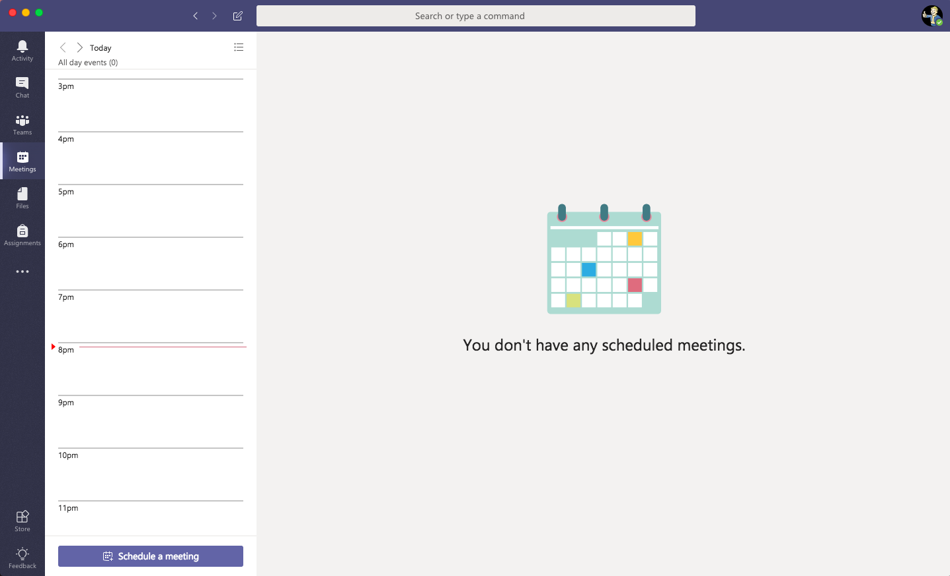
Various office 365 service – Microsoft teams

Slide 20
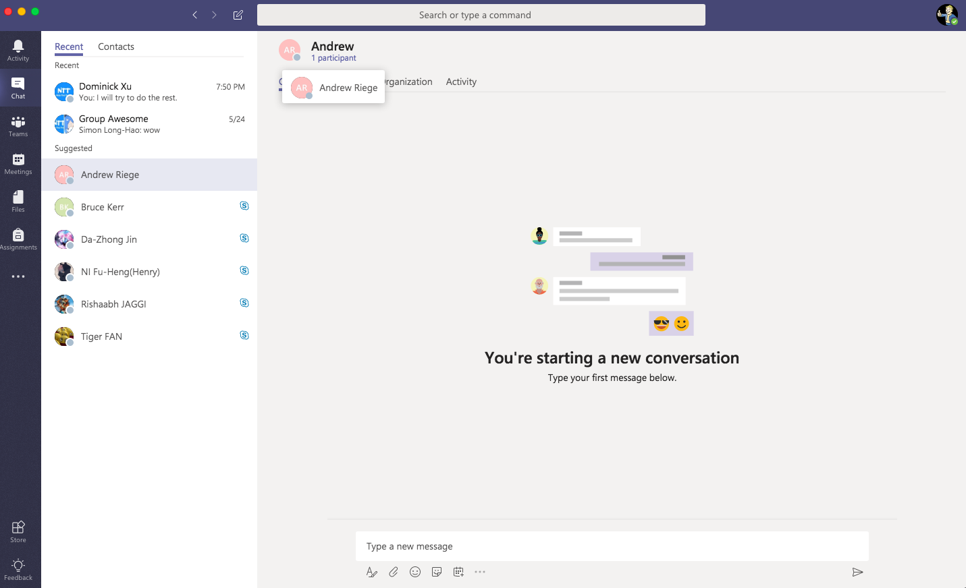
Various office 365 service – Microsoft teams

Slide 21
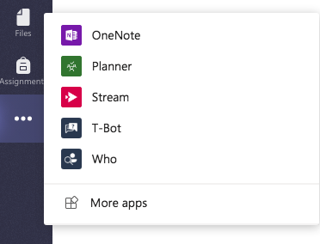
Various office 365 service – Microsoft teams

Slide 22
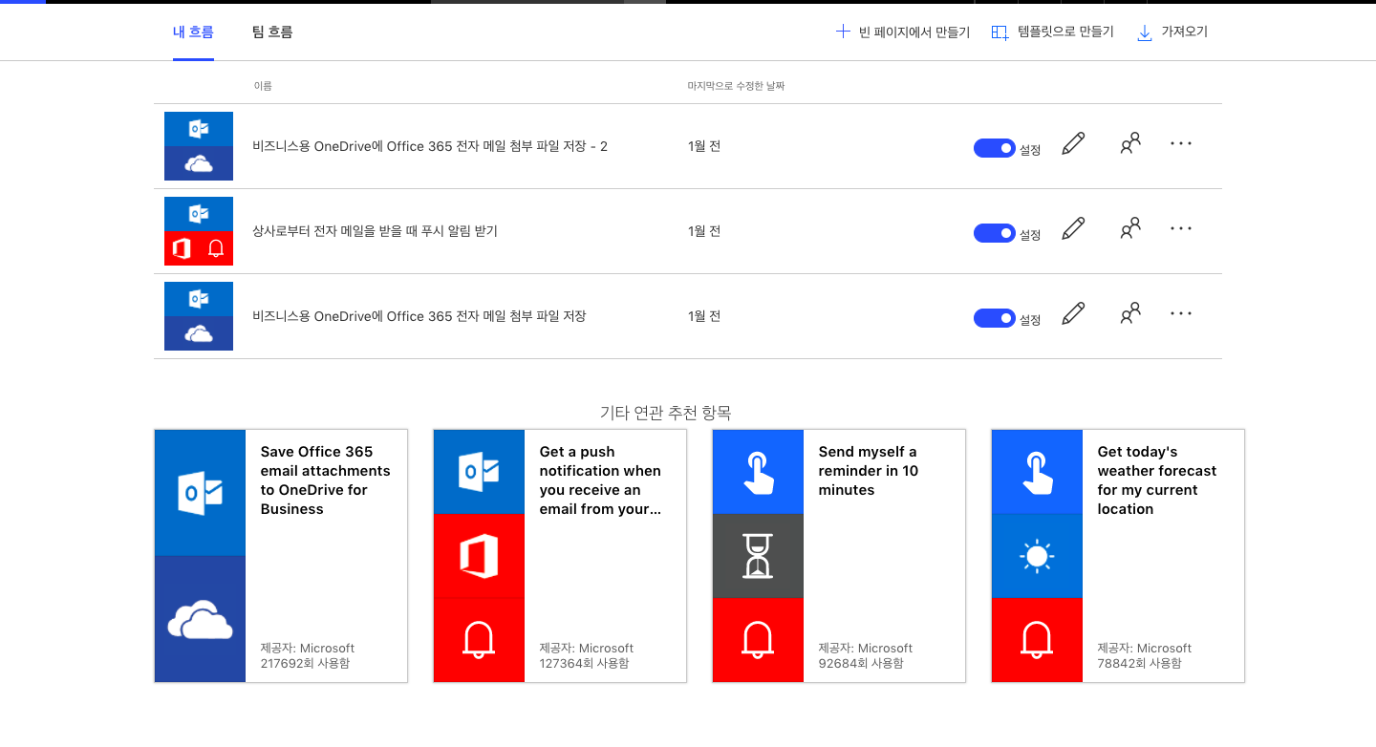
Various office 365 service - flow

Slide 23
Various office 365 service - flow
A simple program builder that is based on same system as Scratch. You can build your code and algorithms in this application to apply to any of your program that is related to Microsoft account.

Slide 24
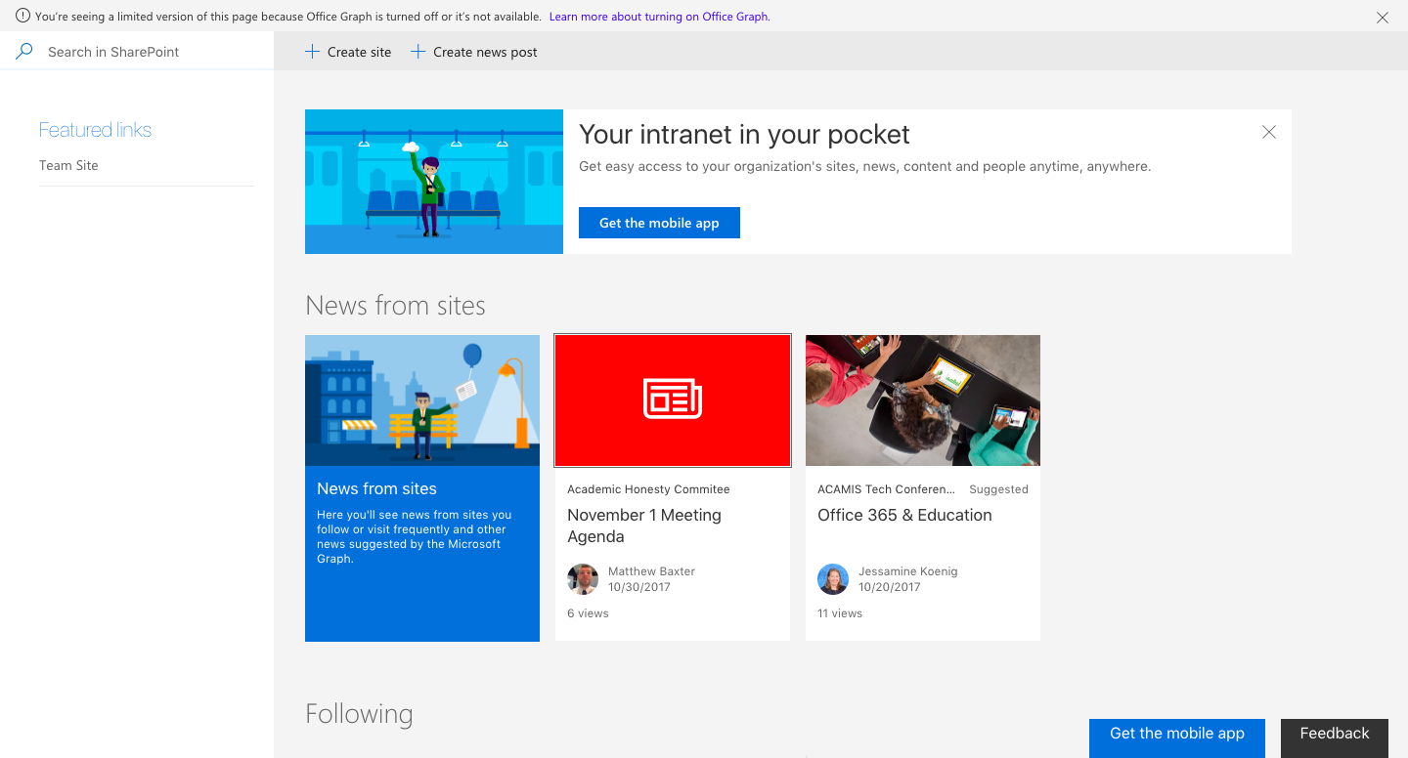
Various office 365 service - sharepoint

Slide 25
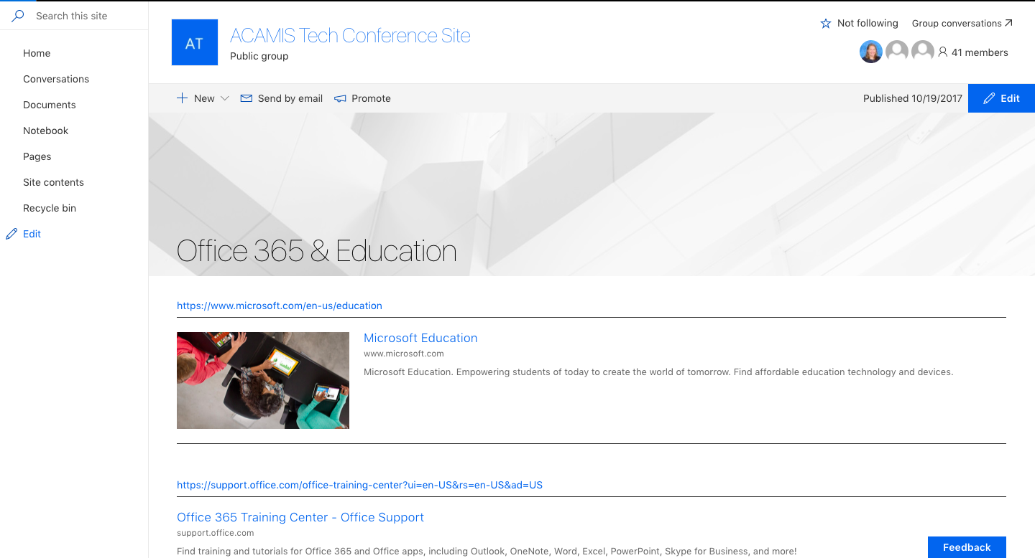
Various office 365 service - sharepoint

Slide 26
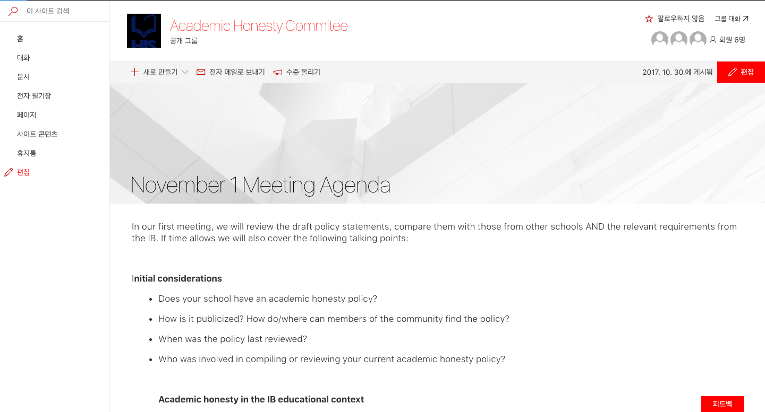
Various office 365 service - sharepoint

Slide 27
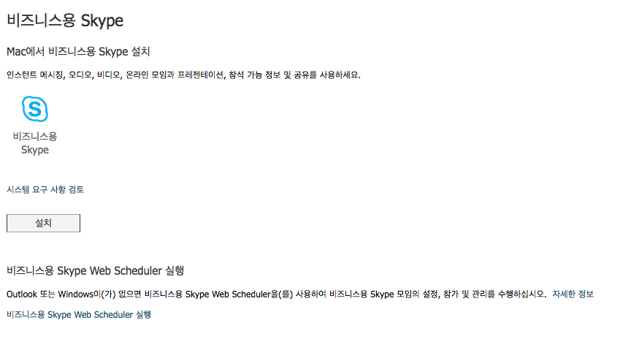
Various office 365 service – skype for business

Slide 28
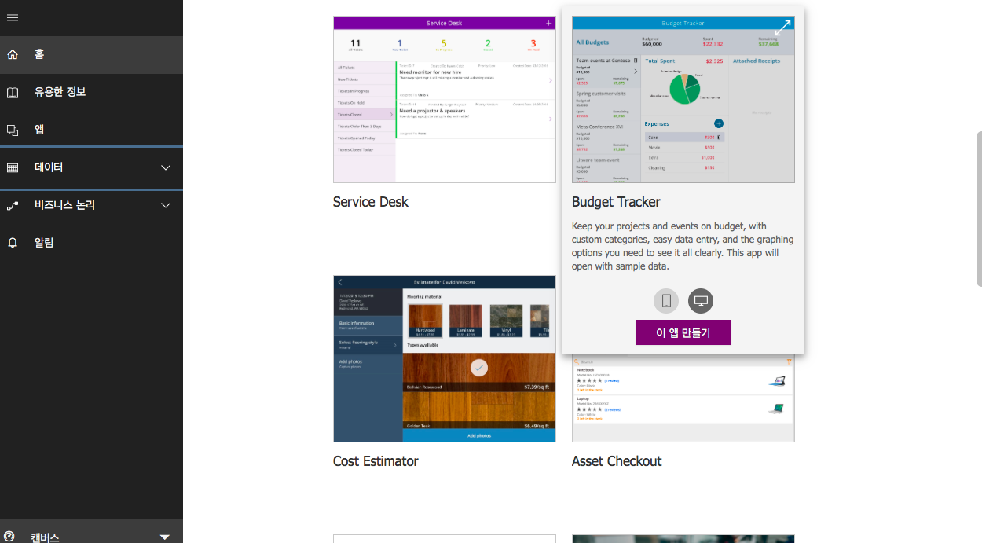
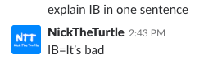
Various office 365 service – Powerapp and dynamics 365

Slide 29
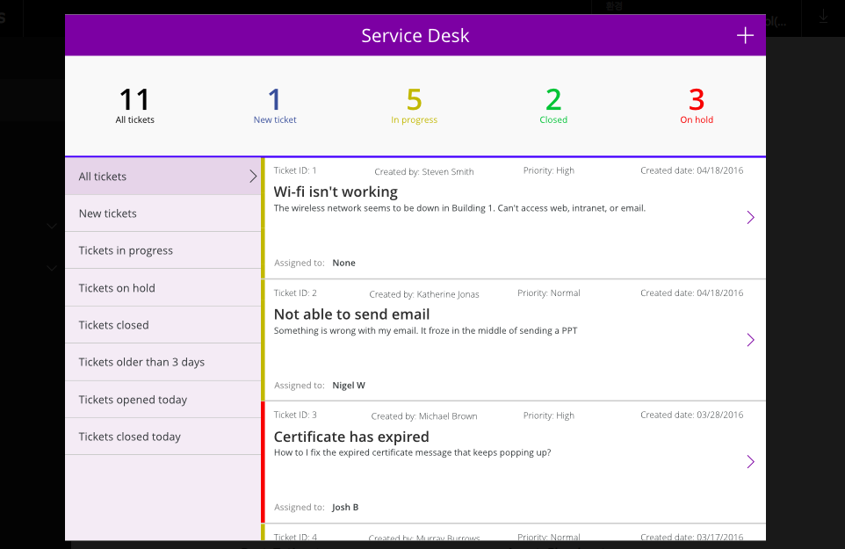

Slide 30
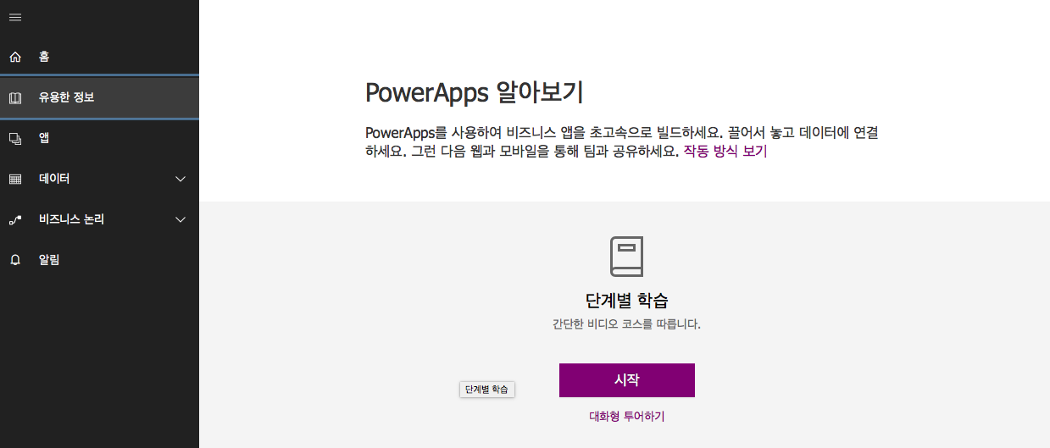

Slide 31
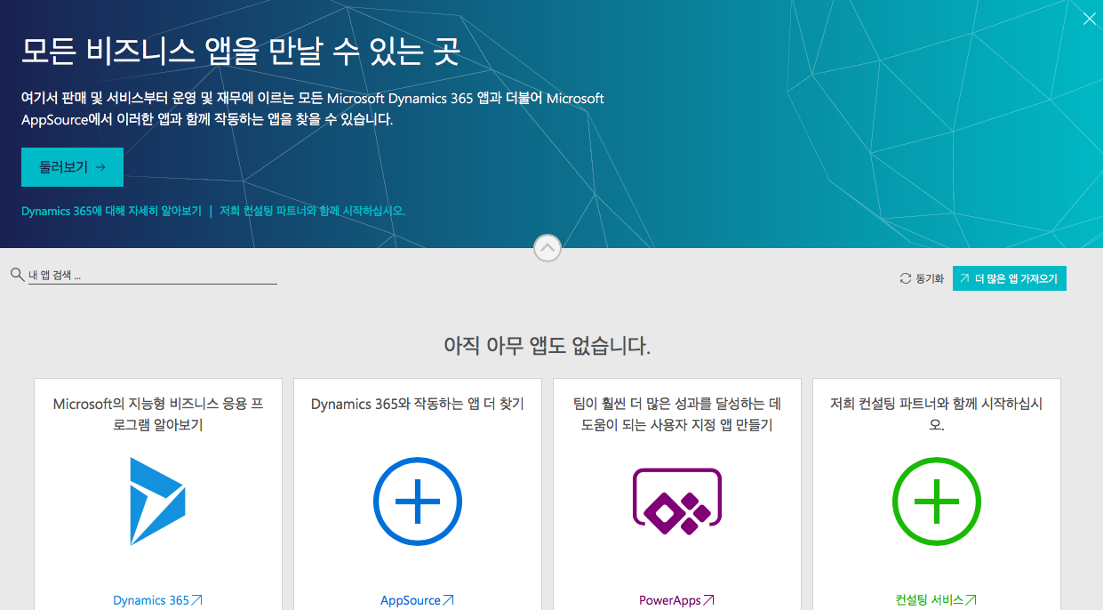

Slide 32
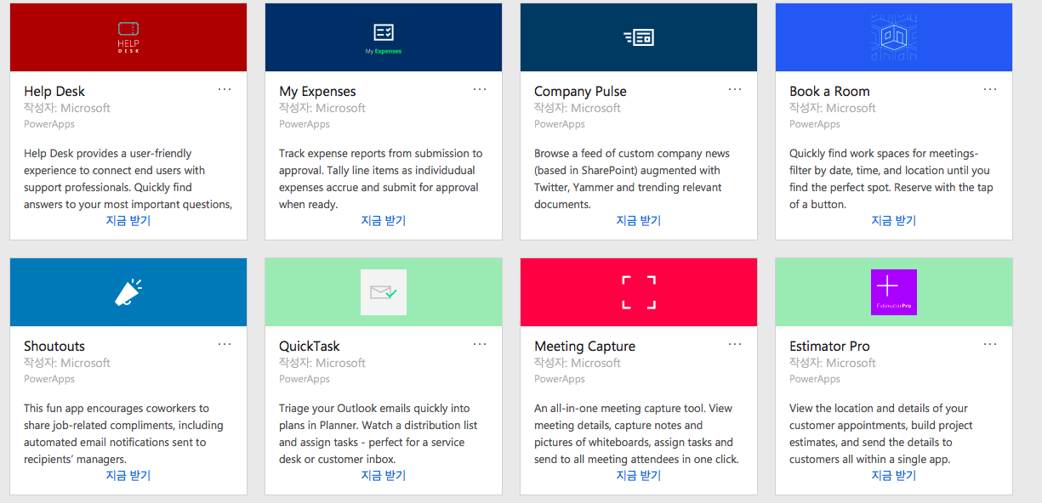

Slide 33
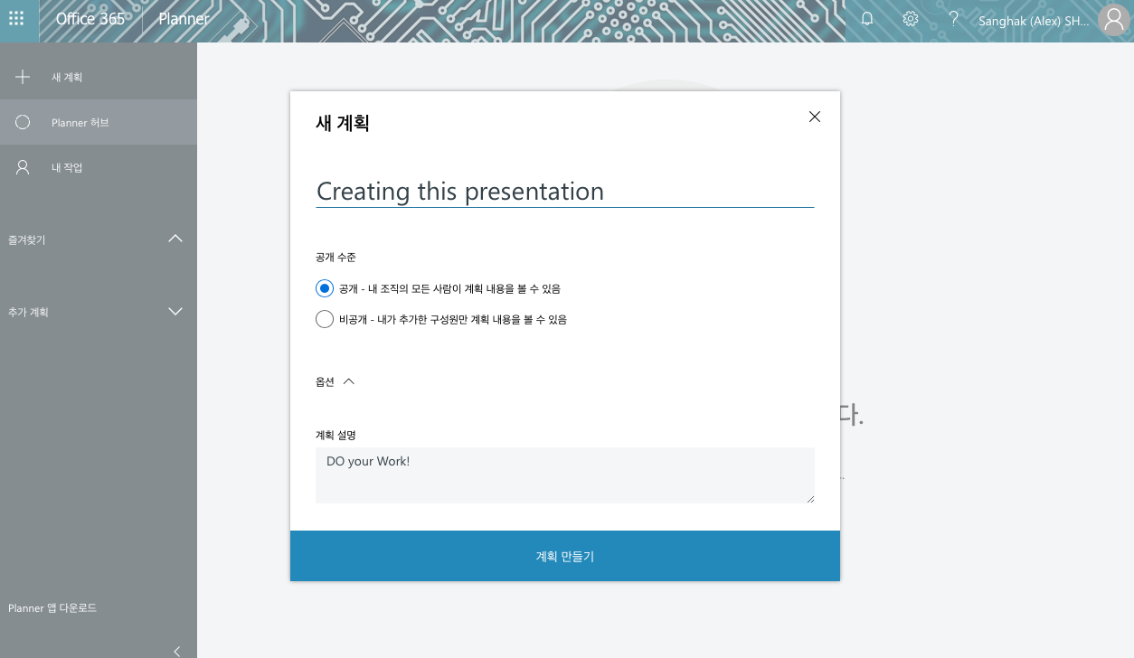
Various office 365 service - Planner

Slide 34
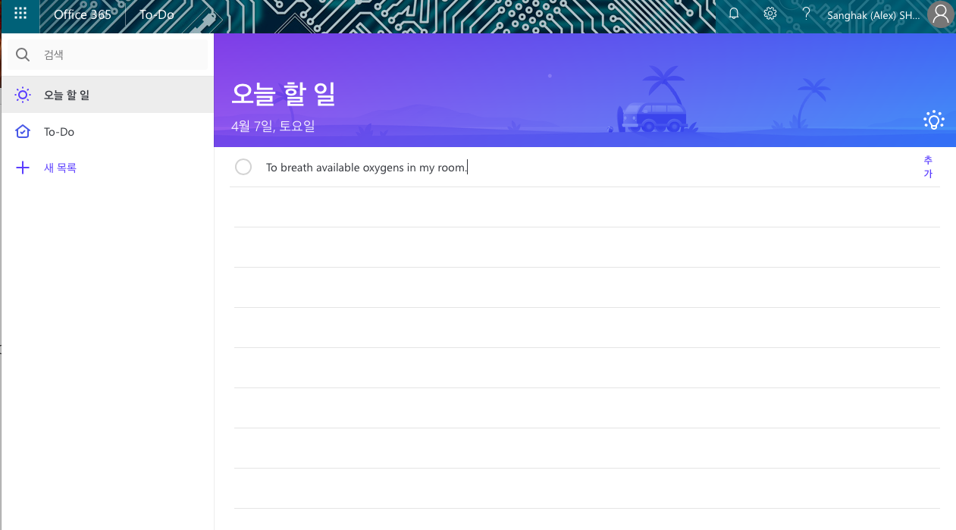
Various office 365 service – To-do

Slide 35
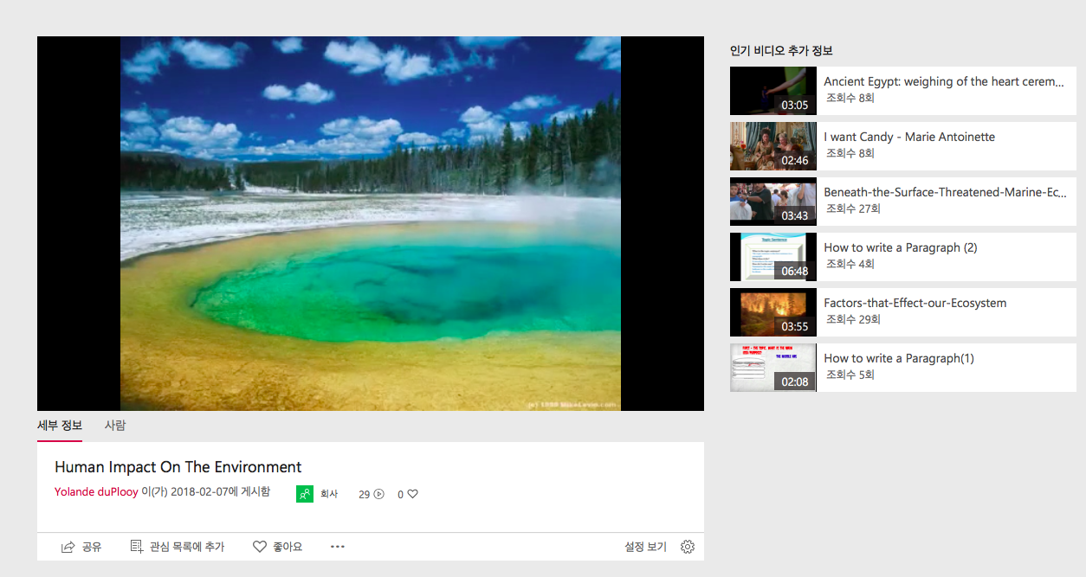
Various office 365 service - Stream

Slide 36
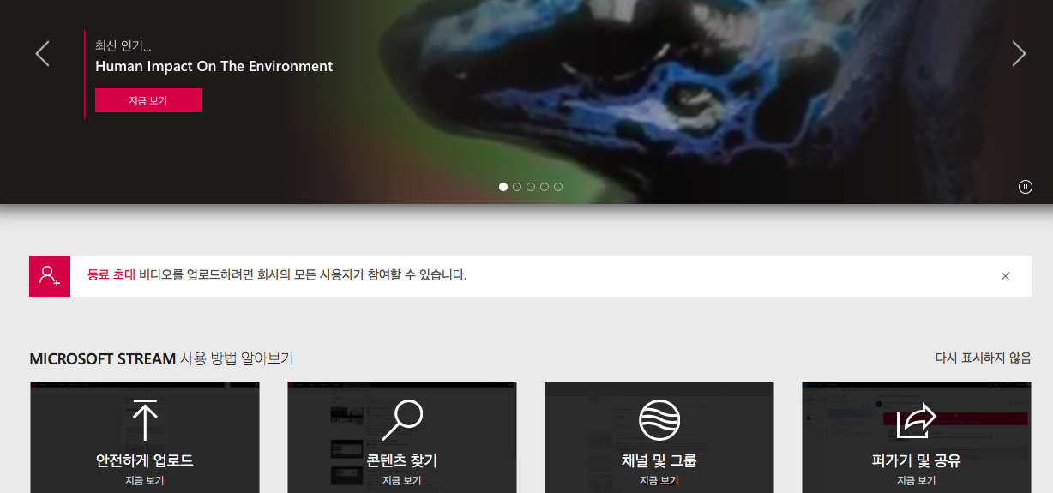
Various office 365 service - stream

Slide 37
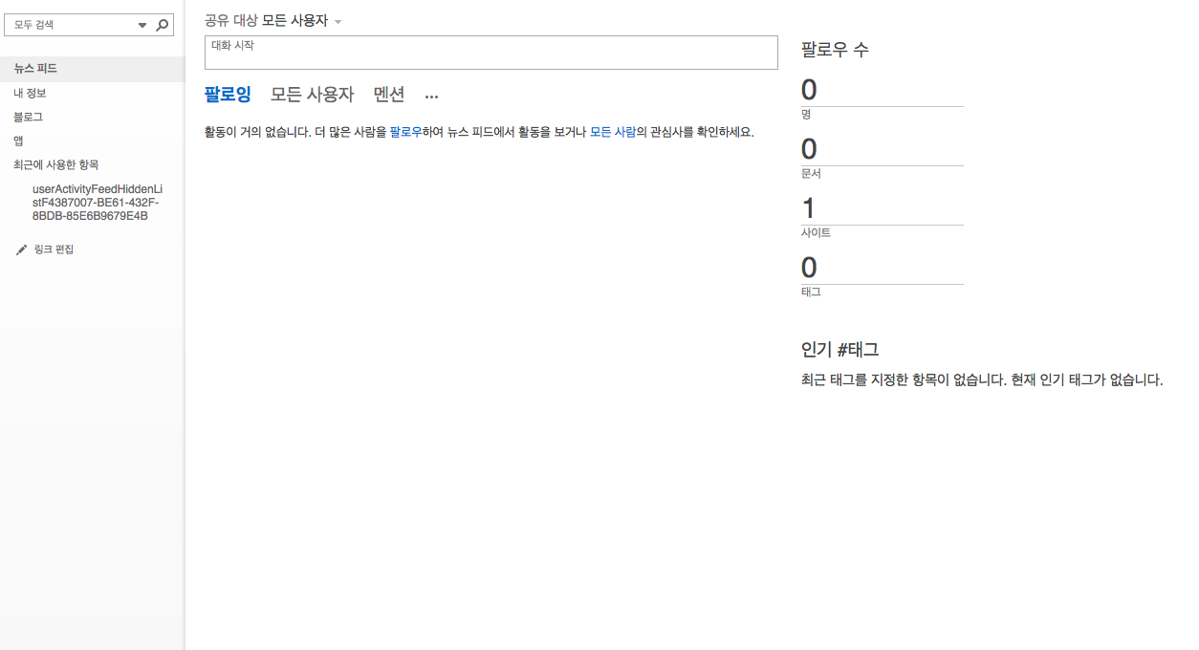
Various office 365 service - newsfeed

Slide 38
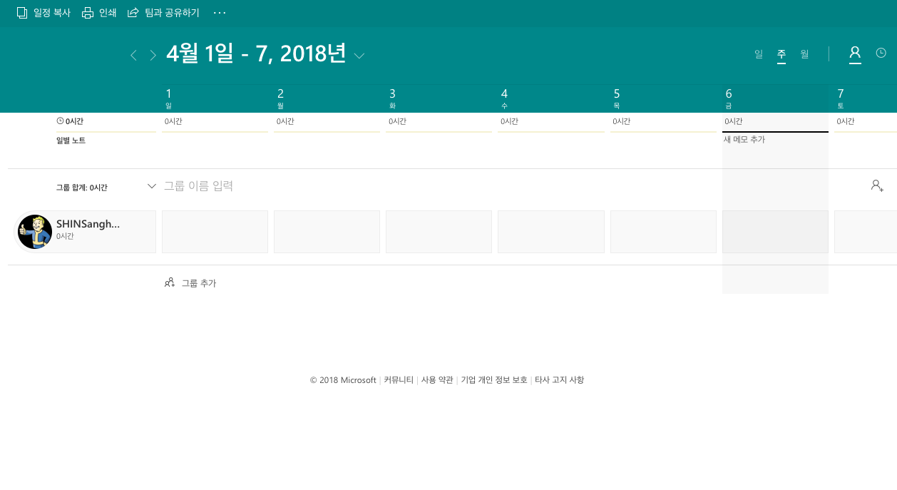
Various office 365 service - staffhub

Slide 39
MS Word
Page breaks
Format painter
Built-in styling
Table of contents
Citations
Review documents
Protect documents
Tables and charts
Headers and footers
Equations

Slide 40
MS Excel
Equations
Formatting (normal + conditional)
Tables and charts
Data validation
Seek a goal

Slide 41
MS PowerPoint
Slide master
SmartArt
Transitions and animations
Links and actions

